Slide 1
Sorting Techniques

Slide 2
What is need of Sorting
Easier to search
Sorting algorithm
Soting
It is easier and faster to locate items in a sorted list than unsorted.
A sorting algorithm will put items in a list into an order, such as alphabetical or numerical order
Sorting a list of items can take a long time, especially if it is a large list. A computer program can be created to do this, making sorting a list of data much easier
Sorting algorithms can be used in a program to sort an array for later searching or writing out to an ordered file or report.

Slide 3

Varoius Sorting Techniques
1
Bubble Sort
2
Insertion Sort
3
selection Sort
4
Merge Sort
5
Quick Sort.

Slide 4

BUBBLE SORT
Bubble sort works on the repeatedly swapping of adjacent elements until they are not in the intended order. works
It is called bubble sort because the movement of array elements is just like the movement of air bubbles in the water. on the
Bubbles in water rise up to the surface; similarly, the array elements in bubble sort move to the end in each iteration.

Slide 5

Bubble Sort

Slide 6
void bubbleSort(int arr[], int n) {
int i, j, temp;
for(i = 0; i < n; i++) {
for(j = 0; j < n-i-1; j++) {
if( arr[j] > arr[j+1]) {
//swap the elements
temp = arr[j];
arr[j] = arr[j+1];
arr[j+1] = temp; }
}
}
}
bubblesort Algorithm

Slide 7
Case | Time Complexity
Best Case | O(n)
Average Case | O(n²)
Worst Case | O(n²)
Analysis of Bubble sort Algorithm

Slide 8
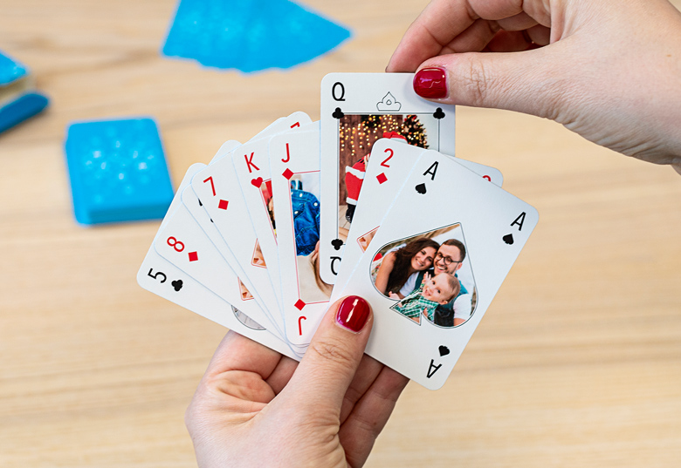
Insertion Sort

Slide 9
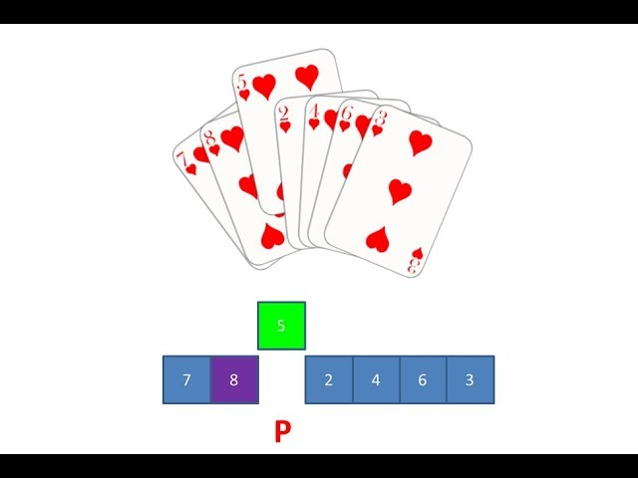
INSERTION SORT
Insertion sort works similar to the sorting of playing cards in hands. It is assumed that the first card is already sorted in the card game, and then we select an unsorted card. If the selected unsorted card is greater than the first card, it will be placed at the right side; otherwise, it will be placed at the left side. Similarly, all unsorted cards are taken and put in their exact place.
The same approach is applied in insertion sort. The idea behind the insertion sort is that first take one element, iterate it through the sorted array.

Slide 10
Insertion Sort

Slide 11
void insert(int a[], int n) /* function to sort an aay with insertion sort */
{
int i, j, temp;
for (i = 1; i < n; i++) {
temp = a[i];
j = i - 1;
while(j>=0 && temp <= a[j])
{
a[j+1] = a[j];
j = j-1;
}
a[j+1] = temp;
}
}
Insertion Sort Algorithm

Slide 12
Best Case | O(n)
Average Case | O(n²)
Worst Case | O(n²)

Slide 13
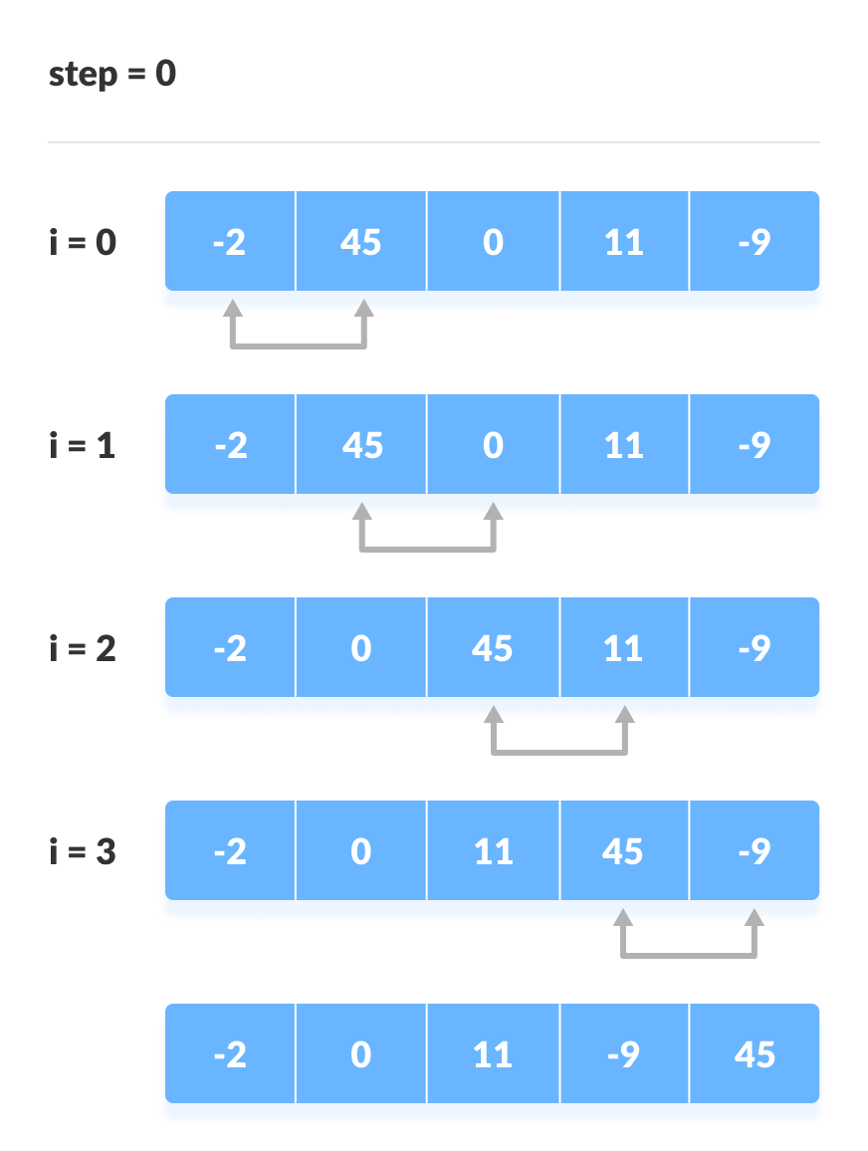
Selection Sort

Slide 14
SELECTION SORT
The same approach is applied in insertion sort. The idea behind the insertion sort is that first take one element, iterate it through the sorted array.
In selection sort, the first smallest element is selected from the unsorted array and placed at the first position. After that second smallest element is selected and placed in the second position. The process continues until the array is entirely sorted.

Slide 15
Selectin Sort

Slide 16
void selection(int arr[], int n)
{
int i, j, small;
for (i = 0; i < n-1; i++)
{
small = i;
for (j = i+1; j < n; j++)
if (arr[j] < arr[small])
small = j;
int temp = arr[small];
arr[small] = arr[i];
arr[i] = temp;
}
}
Selection Sort Algorithm

Slide 17
Case | Time Complexity
Best Case | O(n²)
Average Case | O(n²)
Worst Case | O(n²)

Slide 18
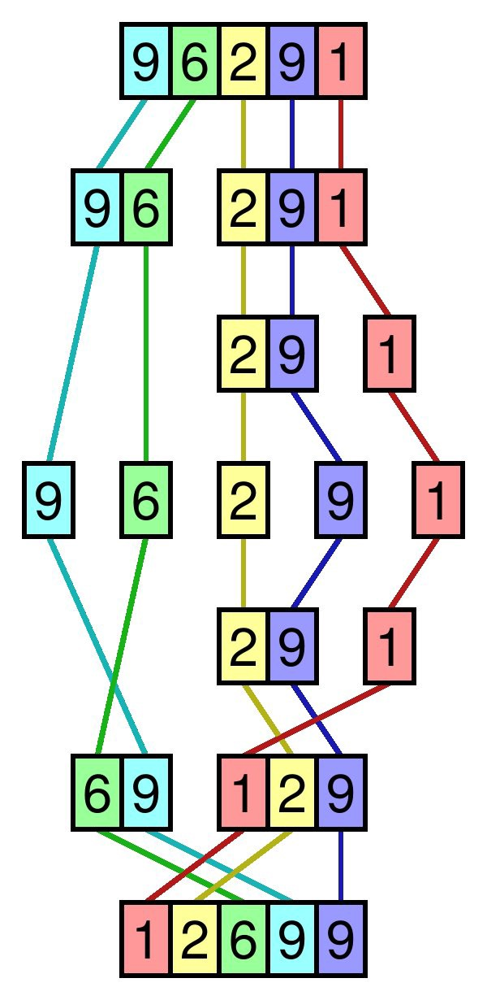
Merge Sort

Slide 19
MERGE SORT
In this technique, we segment a problem into two halves and solve them individually. After finding the solution of each half, we merge them back to represent the solution of the main problem.
In selection sort, the first smallest element The MergeSort function keeps on splitting an array into two halves until a condition is met where we try to perform MergeSort on a subarray of size 1, i.e., p == r.
And then, it combines the individually sorted subarrays into larger arrays until the whole array is merged.

Slide 20
Merge Sort

Slide 21
void merge(int a[], int beg, int mid, int end)
{
int i, j, k;
int n1 = mid - beg + 1;
int n2 = end - mid;
int LeftArray[n1], RightArray[n2];
for (int i = 0; i < n1; i++)
LeftArray[i] = a[beg + i];
for (int j = 0; j < n2; j++)
RightArray[j] = a[mid + 1 + j];
Merge Sort Algorithm

Slide 22
i = 0; /* initial index of first sub-array */
j = 0; /* initial index of second sub-array */
k = beg; /* initial index of merged sub-array */
while (i < n1 && j < n2)
{
if(LeftArray[i] <= RightArray[j])
{
a[k] = LeftArray[i];
i++;
}
else
{
a[k] = RightArray[j];
j++;
}
k++;
}

Slide 23
void mergeSort(int a[], int beg, int end)
{
if (beg < end)
{
int mid = (beg + end) / 2;
mergeSort(a, beg, mid);
mergeSort(a, mid + 1, end);
merge(a, beg, mid, end);
}
}
while (i<n1)
{
a[k] = LeftArray[i];
i++;
k++;
}
while (j<n2)
{
a[k] = RightArray[j];
j++;
k++;
}
}

Slide 24
Case | Time Complexity
Best Case | O(n*logn)
Average Case | O(n*logn)
Worst Case | O(n*logn)

Slide 25
Quick Sort

Slide 26
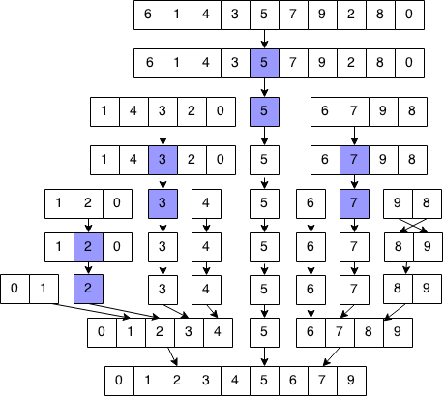
QUICK SORT
Sorting is a way of arranging items in a systematic manner. Quicksort is the widely used sorting algorithm that makes n log n comparisons in average case for sorting an array of n elements. It is a faster and highly efficient sorting algorithm. This algorithm follows the divide and conquer approach. Divide and conquer is a technique of breaking down the algorithms into subproblems, then solving the subproblems, and combining the results back together to solve the original problem..In selection sort, the first smallest element

Slide 27
Quick Sort

Slide 28
int partition (int a[], int start, int end)
{
int pivot = a[end]; // pivot element
int i = (start - 1);
for (int j = start; j <= end - 1; j++)
{
if (a[j] < pivot)
{
i++;
int t = a[i];
a[i] = a[j];
a[j] = t;
}
}
int t = a[i+1];
a[i+1] = a[end];
a[end] = t;
return (i + 1);
}
Quick sort Algorithm

Slide 29
void quick(int a[], int start, int end) /* a[] = array to be sorted, start = Starting index, end = Ending index */
{
if (start < end)
{
int p = partition(a, start, end); //p is the partitioning index
quick(a, start, p - 1);
quick(a, p + 1, end);
}
}
Quick sort Algorithm

Slide 30
Case | Time Complexity
Best Case | O(n*logn)
Average Case | O(n*logn)
Worst Case | O(n²)

